Slide 1
Antigens
Outline
a. Define and describe the basic requirements for immunogenicity.
b. Define and describe Ag, immunogen, and antigenic determinant or epitope.
c. Compare and contrast a linear versus a conformational epitope.
d. Describe what a hapten is and how it helped define the specificity of the immune system.
e. Describe adjuvant and list examples.
f. Define cross-reactivity and its effect on assays and responses
g. Compare B cell and T cell epitopes

Slide 2
Antigens
Definition
Immunogen: a stimulus that produces a humoral or cell-mediated immune response
Antigen: any substance that binds specifically to an Ab or a T-cell receptor
All immunogens are antigens but not all antigens are immunogens

Slide 3
Factors affect Immunogenecity
Foreignness
Self and nonself recognition
Degree of foreignness
Genetic makeup
species to species and different individuals of the same species
Injection route and the Ag dose
  Parenterally injection of an Ag is more effective than gastrointestinal entrance including orally
  IV, IP, IM, SC, ID
  IV: fast i.r
  SC: the strongest i.r
  IM: most common and strong i.r
  Intranasal: elicit allergy
  Orally: local i.r and tolerance

Slide 4
Molecular weight
  Minimum size of a molecule to be antigenic
  No definitive threshold for all molecules
  Generally, <1000 D not immunogenic
  <1000-6000 weak
  >6000 immunogenic
  The higher the MW is the more the antigenicity will be
  a.a., glucose are not antigenic
  Oxytocin (1KD) is antigenic

Slide 5
  Molecular Complexity
Immunogenicity is directly proportional to the molecular complexity of the molecule
Proteins more antigenic than Carbohydrates
lipids (TG, cholesterol), DNA, RNA not antigenic
Homopolymers of carbohydrates and proteins are not antigenic: poly-γ-D-glu of B anthracis
Starch, polyGlu, polyethylene (Plastic)
Quaternary S > tertiary> secondary> Primary
Aromatic a.a increase antigenicity of a protein (gelatin)

Slide 6
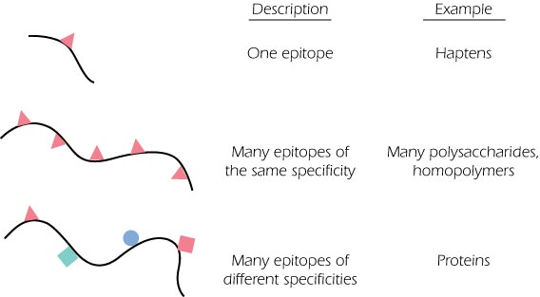

Slide 7
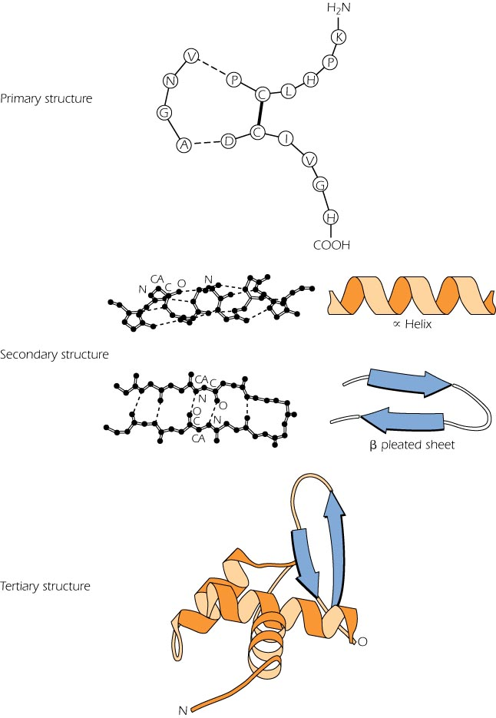

Slide 8
Degradability
For Ag presentation:
a. to be antigenic, the substance has to be stable
flexible gelatin, flagellin
b. The substance must be susceptible to partial degradation by enzymes
Nonmetabolised materials: e.g polyethylene plastics
Poly D-amino acids
Carbohydrates are not presented by APCs so unable to activate T cells but can activate B cells like LPS.

Slide 9
Antigenic determinants (EPITOPES)
Small parts of an Ag are responsible for antigenicity (epitopes)
  the portion of an Ag that is recognized and bound by an Ab or TCR/MHC complex
  Consist of 4-6 glu (0.5-1KD) or 3-5 a.a (0.3-0.5 KD)
  Each 10 KD can have 1 epitope
  Exposed and hidden epitopes

Slide 10
Linear and conformational epitopes
Linear epitopes consist of continuous residues on a protein sequence.
Conformational epitopes consist of residues that are discontinuous in the protein sequence yet come within close proximity to form an antigenic surface on the protein's three-dimensional structure.
A linear or a sequential epitope is an epitope that is recognized by Abs by its linear sequence of amino acids, or primary structure. In contrast, most antibodies recognize a conformational epitope that has a specific three-dimensional shape and its protein structure.
Linear epitopes are short and continuous. After denaturation the linear epitopes may still be able to bind the Ab. ... Conformational epitopes are domains of proteins composed of specific regions of protein chains. After denaturation the discontinuous epitope can no longer bind the Ab.

Slide 11
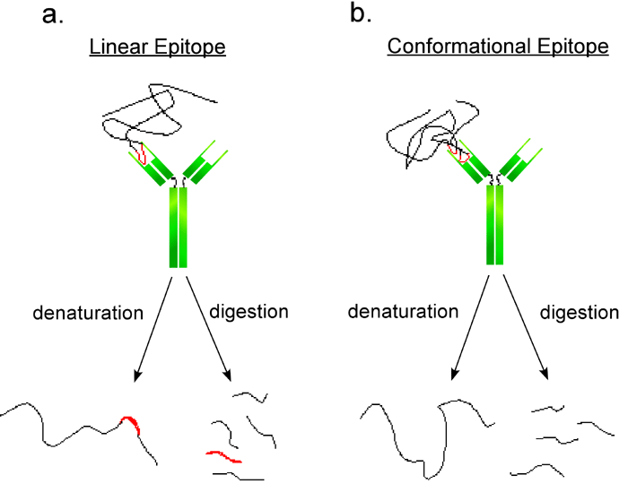
Fig :Schematic representation of two antibodies interacting with linear and conformational epitopes.
a. Linear epitopes are short and continuous. After denaturation the linear epitopes may still be able to bind the Ab.
b. Conformational epitopes are domains of proteins composed of specific regions of protein chains. After denaturation the discontinuous epitope can no longer bind the Ab.

Slide 12
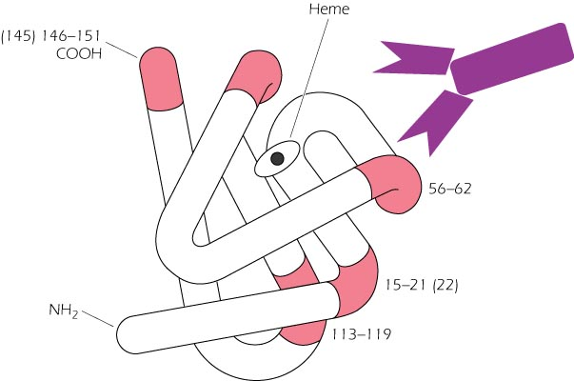

Slide 13
Table 2.2. Ag determinants (epitopes)
 | Conformational determinant | Linear determinant
Location | Most globular proteins and native nucleic acids | Most polysaccharides, fibrilar proteins, and single- stranded nucleic acids
Composition | Amino acid residues brought into proximity to one another by folding | Adjacent amino acid residues in the covalent sequence
Ag-Ab reaction | Dependent on 3-dimensional structure | Dependent on linear structure of 6 amino acids
Availability for Ab interaction | Usually associated with native proteins | Become available upon denaturation of proteins

Slide 14
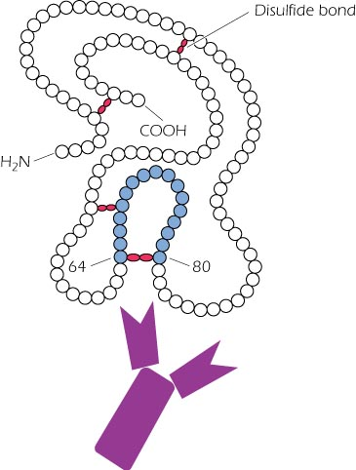

Slide 15
Haptens
Small molecule that is not antigenic by itself but after conjugation with a carrier molecule, it becomes antigenic
can bind to Ab’s or TCR’s but they cannot initiate an immune response
H-----Nonantigenic
H-----C antigenic
Nucleoprotein, Lipoprotein, LPS, Glycoprotein are antigenic: nucleotides, lipids, and sugar act as haptens
Significance: penicillin hypersensitivity, cosmetic allergy
The same Hapten but different carrier: specific antigenicity depend on the carrier (PABA, PASA, PAAA)
Different H but the same C gives cross reactions
Spatial configuration effect: p, o, m and D,L show specificity
The IR is independent on the charge of the Ag

Slide 16
Types of Ags
Carbohydrates
  Polysaccharides: can be antigenic and activate B cells in the absence of T cells.
  Glycoproteins: T cell dep i.r against the sugar and against the protein
  Side chains of polysaccharides (blood groups, teichoic acid) Cannot activate T cells

Slide 17
Lipids
  rarely immunogenic
  lipoproteins and glycolipids are immunogenic
  Nucleic acids
  Poor immunogenic
  Nucleoprotein are immunogenic
  DNA (native helical) not immunogenic

Slide 18
Cross reactions
(Heterophile Ags): Common epitopes in different molecules
ABO :B blood group & E. coli, A & Pneumococcal capsular polysaccharde
Proteus vulgaris and R typhi: weil-felix test
Forssman Ag:
A human serum positive for infectious mononuclosis caused by EBV agglutinate horse RBCs (heterophile Ab test).
Mono, or infectious mononucleosis, refers to a group of symptoms usually caused by the Epstein-Barr virus (EBV). The virus is spread through saliva, which is why some people refer to it as “the kissing disease.”
Toxin and toxoid

Slide 19
Adjuvants
Vehicles that are added to enhance the i.r
Mixing Does not confer immunogenicity
Mechanism:
binds to proteins & precipitate them
inflammation : that is nonspecifically increase the immunogenecity of the Ag
gradual Ag delivery: the precip. Ag is released more slowly at the injection site causing secondary i.r.
Increased Ag size: increases the phagocytosis and Ag presentation
In animals: Freund complete adjuvant (FCA)
consist of killed M tuberculosis suspended in oil which is emulsified with an aqueous Ag solution.
IFA: CFA without the M tuberculosis

Slide 20
Licensed Adjuvants for use in human vaccines
Alum mineral salt
AlPhosphate, Alhydroxide
Virosome (2000) Liposomes
Lipid and hemagglutinin
AS03 (2009) Oil in water emulsion
squaline, tween, α-tocopherol
AS04 (2005) Alum -absorbed TLR4 agonist
Alhydroxide and lipid A

Slide 21

B cell epitope and T cell epitope
BCR TCR
Ag interaction protein, polysacch., lipids peptides
Binding soluble Ag Yes No
Epitopes sequential or linear denatured peptides
conformational must be processed by APC
outside of the mol. Internal Continuous
terminal side chains of COH
hydrophilic Hydrophobic

Slide 22
 | BCR | TCR
Composition | Proteins, polysaccharides, nucleic acids | Proteins
Configuration | Linear/conformational determinants | Linear determinants
Size | 4–8 residues | 8–15 residues
Number | Limited, located on the external surface of the Ag | Limited to those that can bind to MHC

